Slide 1
MiCK (Microbial Chemoresistance Knowledgebase)

Slide 2
Interface
4 pages
Home
Search
Download
About

Slide 3
Home page
Welcome note
Graphical abstract
Other pages information

Slide 4
Search page
Selection box
Search box
Search button
Searching conditions
Drug
Gene Type
Effect

Slide 5
Download page
Download table
Data download button
Material to be downloaded
Database Table (126 MB)
Sequences Files
Clustered at 90 % (607 MB)
Clustered at 100 %(1.13 GB)

Slide 6
About page
FAQ’s
Team
Key statistics

Slide 7
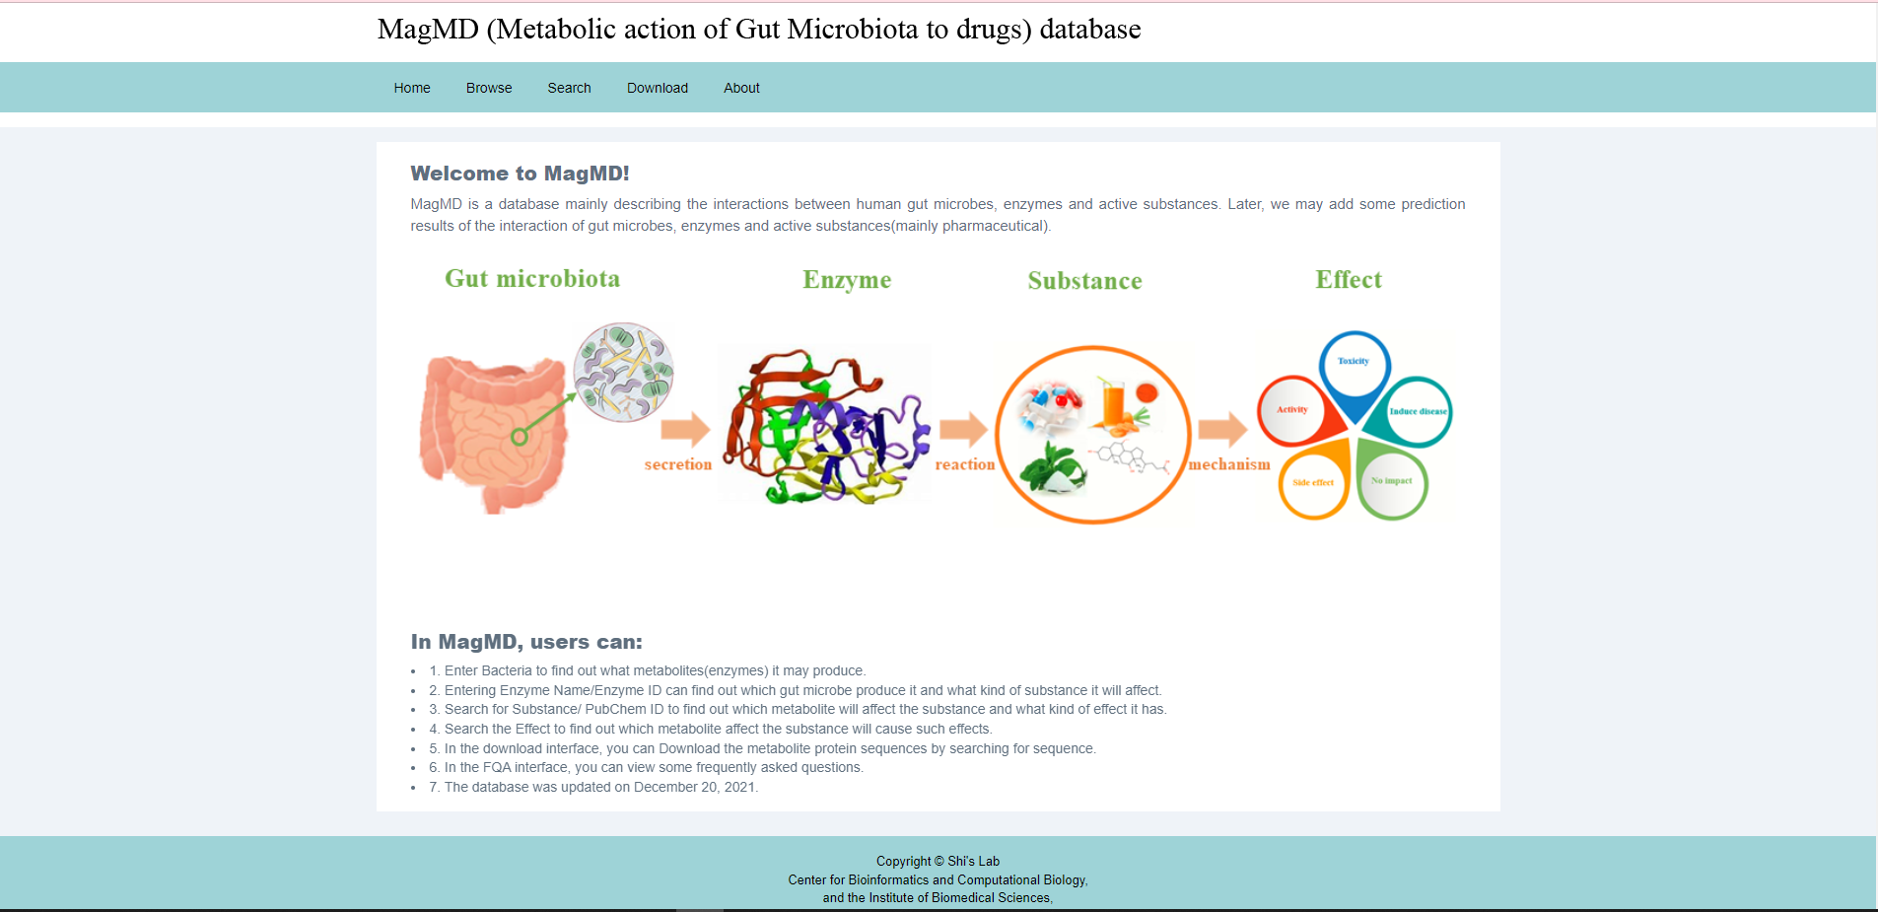
References
http://119.3.41.228/MagMD/index.php

Slide 8
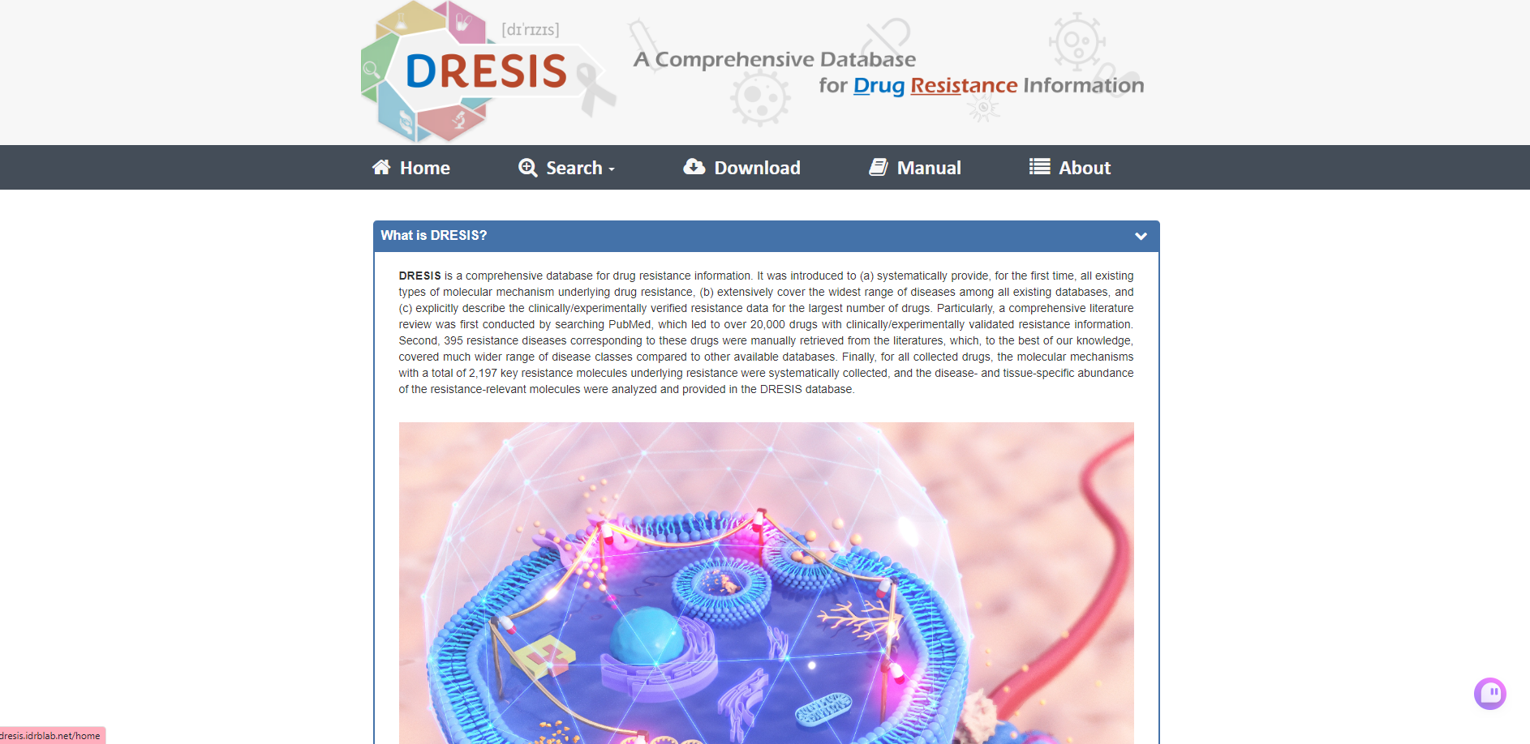
References
http://dresis.idrblab.net/about

Slide 9
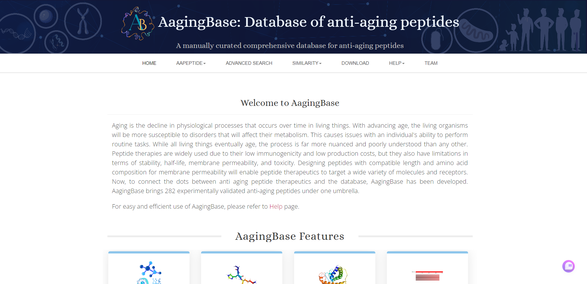
References
https://project.iith.ac.in/cgntlab/aagingbase/

